Slide 1
Discrete Structure Relations
Week 7
By
Dr. Rafiullah Khan

Slide 2
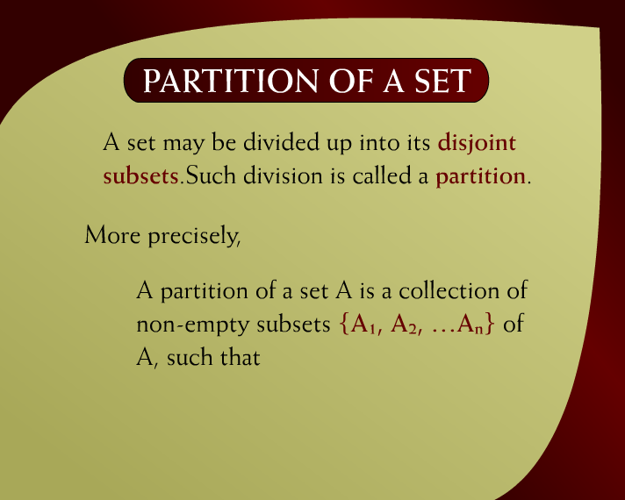
Partition of a Set – (10 - 34)

Slide 3
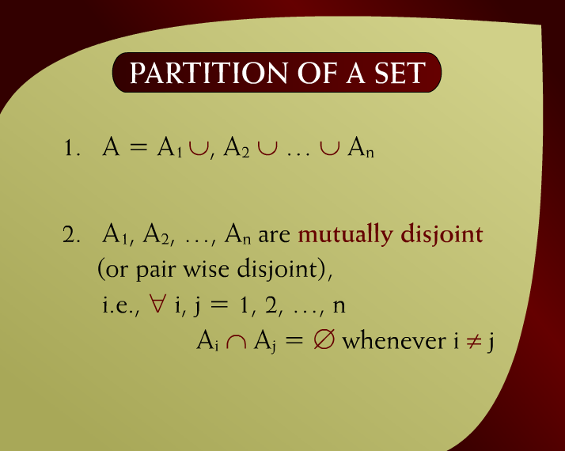
Partition of a Set – (10 – 34a)

Slide 4
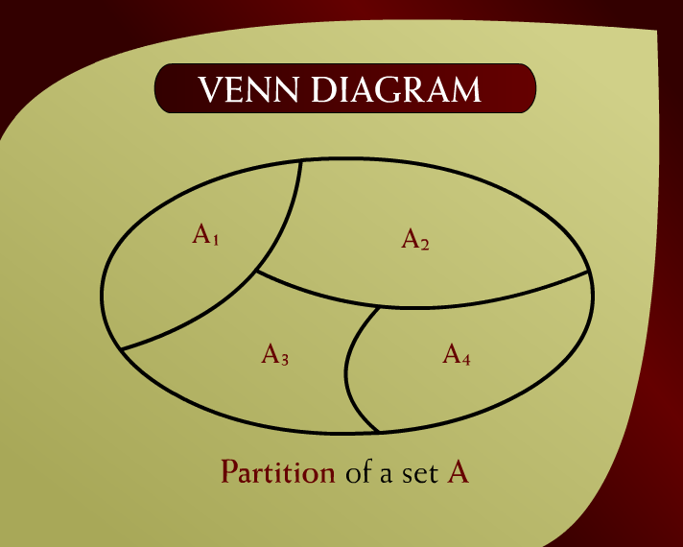
Venn Diagram – (10 - 35)

Slide 5
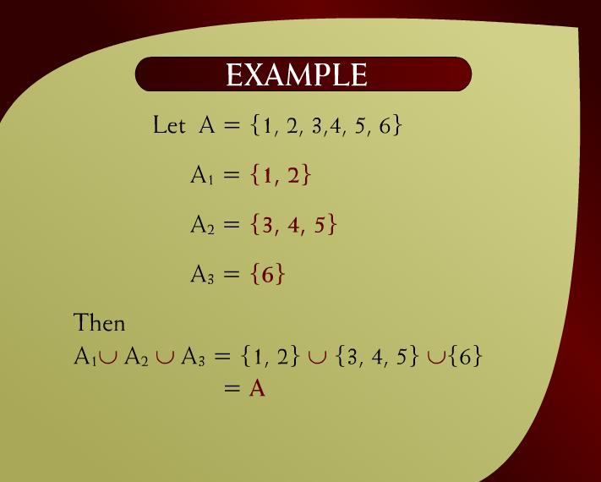
Example – (10 - 36)

Slide 6
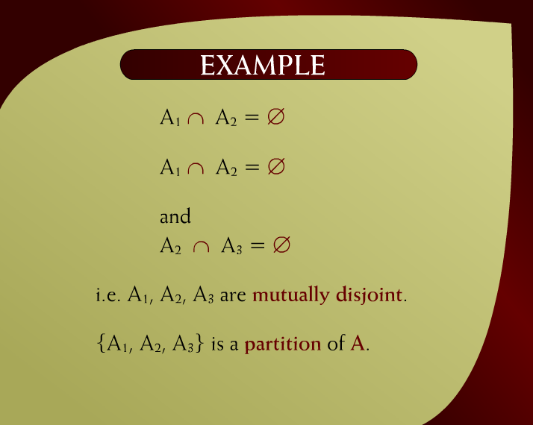
Example – (10 – 36a)

Slide 7
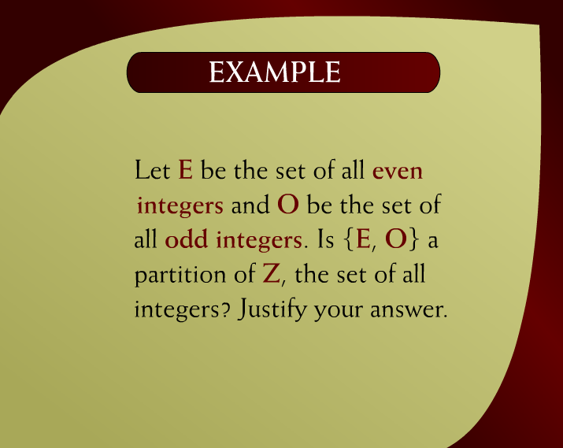
Example – (10 - 37)

Slide 8
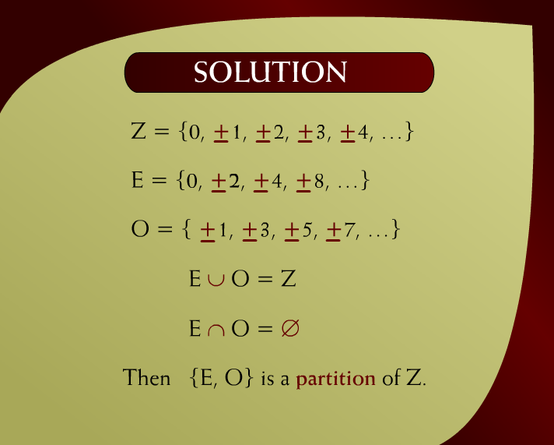
Solution – (10 – 37a)

Slide 9
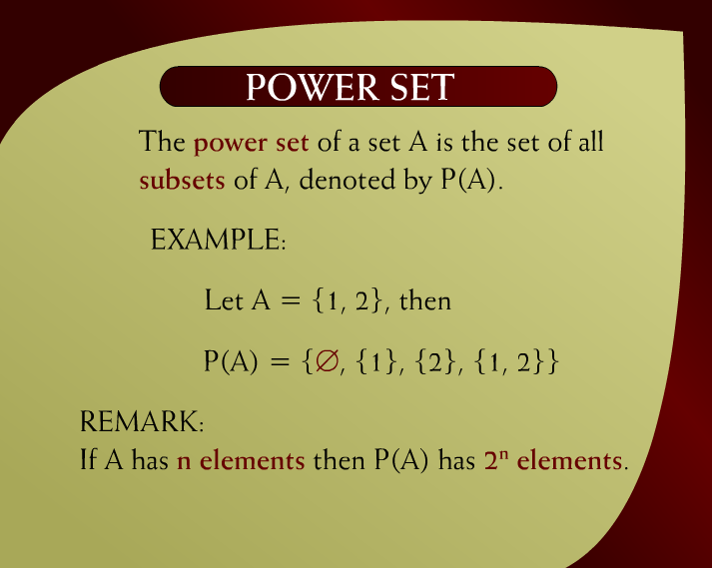
Power Set – (10 - 39)

Slide 10
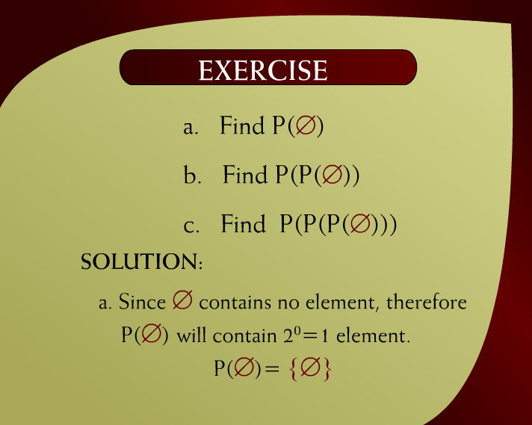
Exercise – (10 - 40)

Slide 11
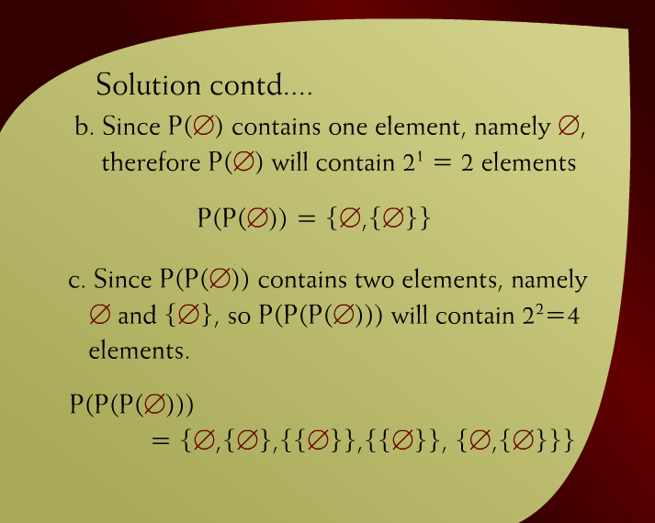
Solution Continued – (10 – 40a)

Slide 12
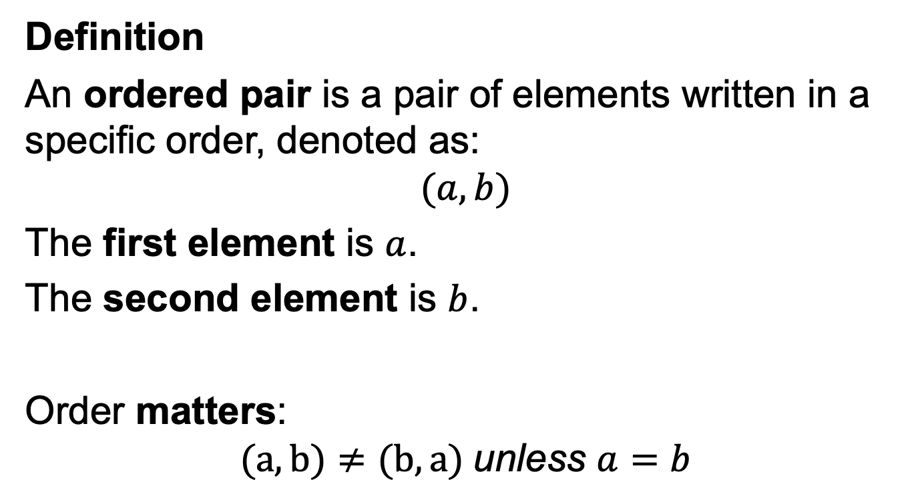
Ordered Pair
Definition
An ordered pair is a pair of elements written in a specific order, denoted as:
$$(a,b)$$
The first element is $a$.
The second element is $b$.
Order matters:
$$(a,b)≠(b,a) \text{unless} a=b$$

Slide 13
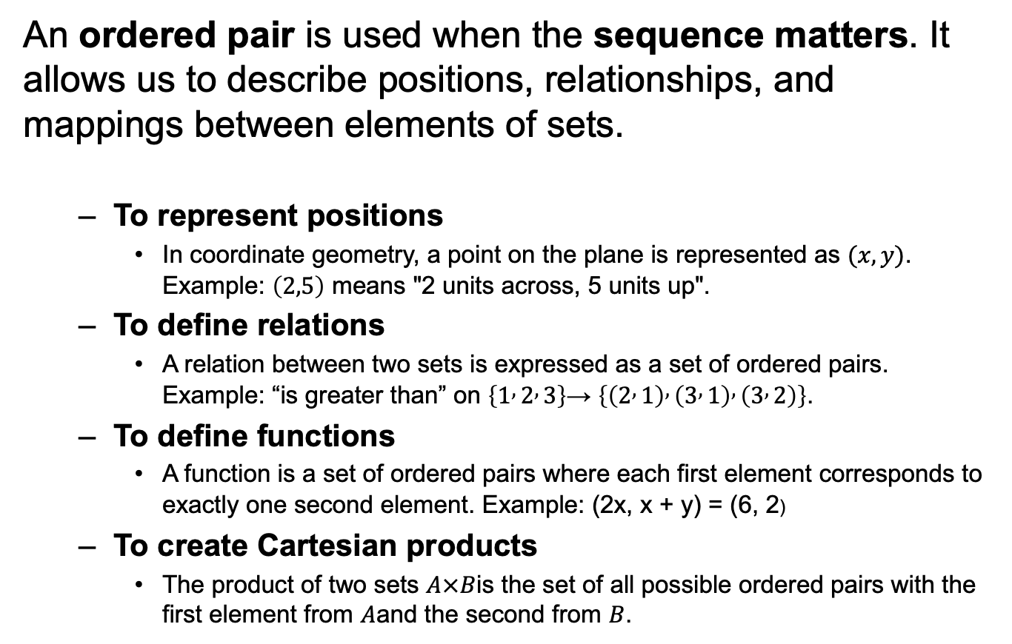
Why Do We Use Ordered Pairs?
An ordered pair is used when the sequence matters. It allows us to describe positions, relationships, and mappings between elements of sets.
To represent positions
In coordinate geometry, a point on the plane is represented as $(x,y)$. Example: $\left(2,5\right)$ means "2 units across, 5 units up".
To define relations
A relation between two sets is expressed as a set of ordered pairs. Example: “is greater than” on $\left\{1 , 2 , 3\right\}$→ $\left\{\left(2 , 1\right) , \left(3 , 1\right) , \left(3 , 2\right)\right\}$.
To define functions
A function is a set of ordered pairs where each first element corresponds to exactly one second element. Example: (2x, x + y) = (6, 2)
To create Cartesian products
The product of two sets $A×B$is the set of all possible ordered pairs with the first element from $A$and the second from $B$.

Slide 14
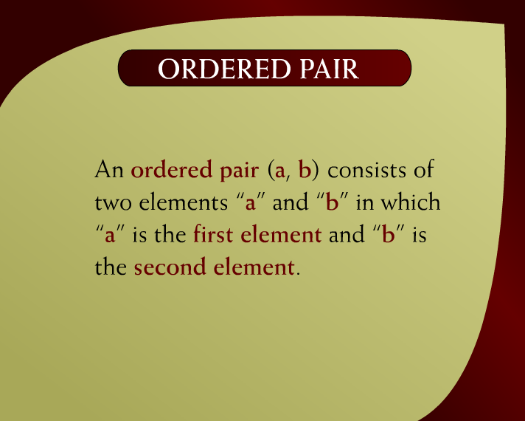
Ordered Pair – (11 - 2)

Slide 15

Exercise – (11 - 3)

Slide 16
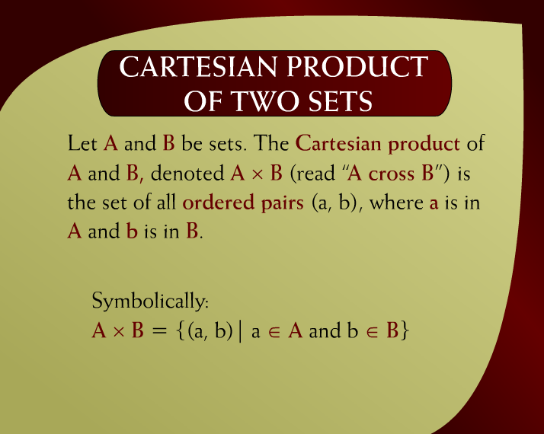
Cartesian Product of Two Sets – (11 – 5)

Slide 17
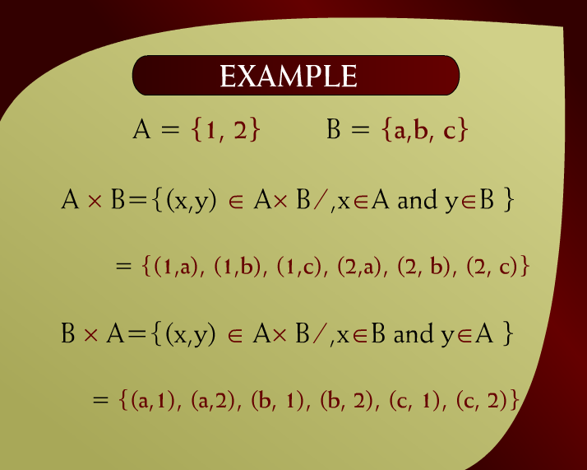
Example – (11 - 6)
Find:
A x B
and
B x A

Slide 18
Example – (11 - 6)

Slide 19
Example – (11 - 6)
Find:
A x A
and
B x B

Slide 20
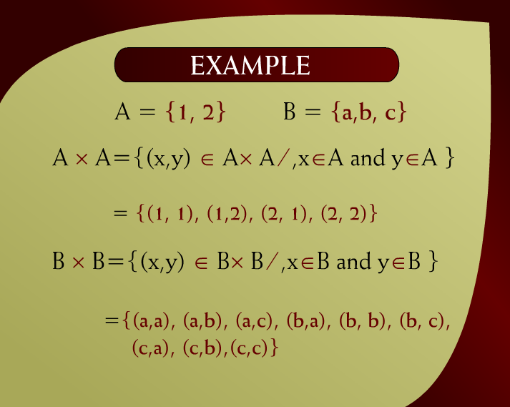
Example – (11 – 6a)

Slide 21
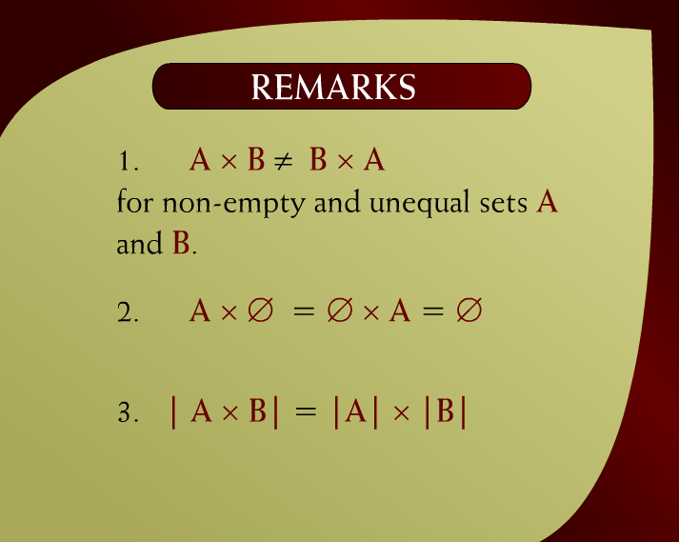
Remarks – (11 – 6b)

Slide 22
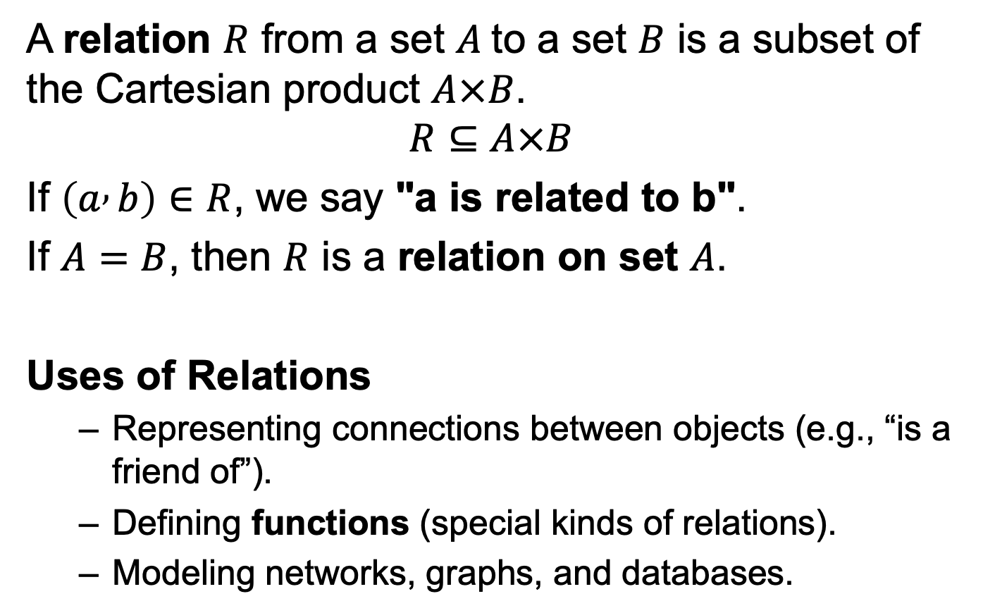
Relations
A relation $R$ from a set $A$to a set $B$ is a subset of the Cartesian product $A×B$.
$$R⊆A×B$$
If $\left(a , b\right)∈R$, we say "a is related to b".
If $A=B$, then $R$ is a relation on set $A$.
Uses of Relations
Representing connections between objects (e.g., “is a friend of”).
Defining functions (special kinds of relations).
Modeling networks, graphs, and databases.

Slide 23

Relation – (11 - 9)

Slide 24

Example – (11 – 9a)

Slide 25
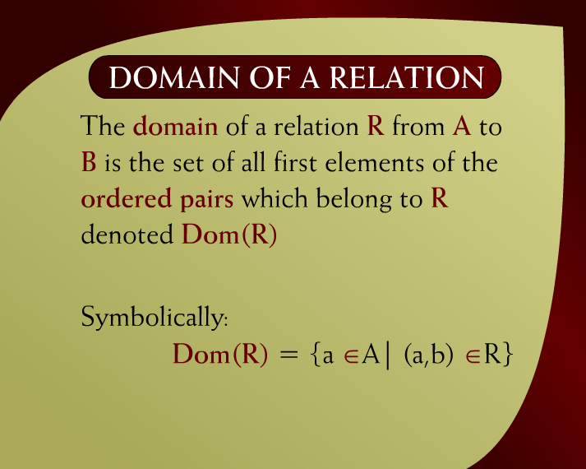
Domain of a Relation – (11 - 10)

Slide 26

Range of Relation – (11 – 10a)

Slide 27
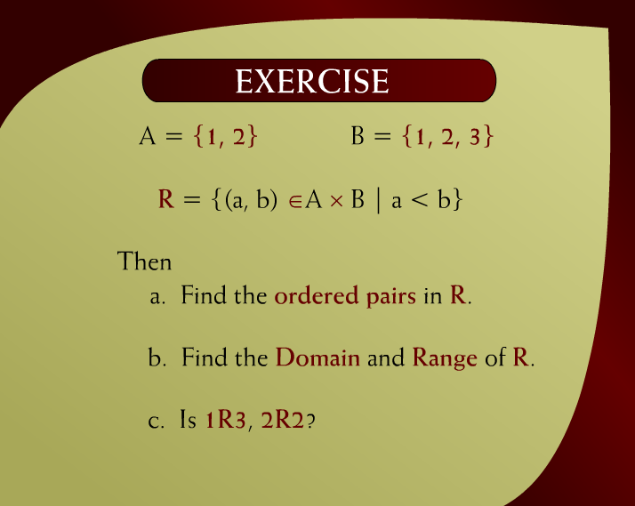
Exercise – (11 - 11)

Slide 28

Solution – (11 – 12)

Slide 29
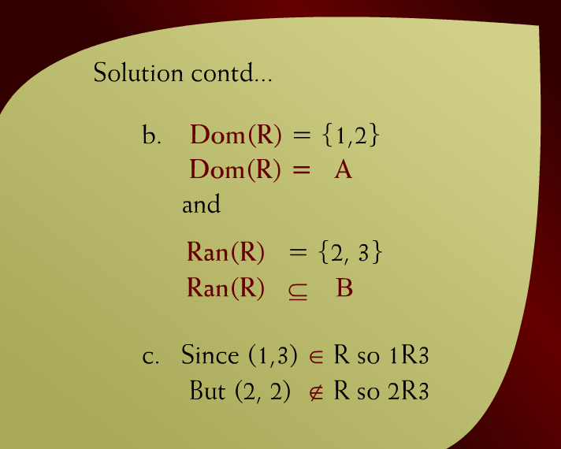
Solution Continued – (11 – 12a)

Slide 30
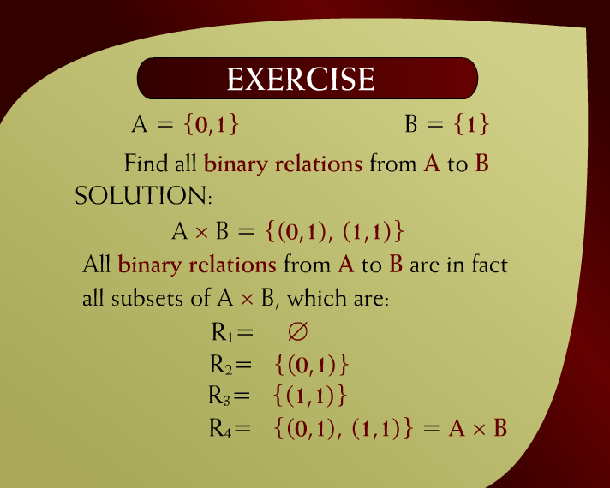
Exercise – (11 - 14)

Slide 31
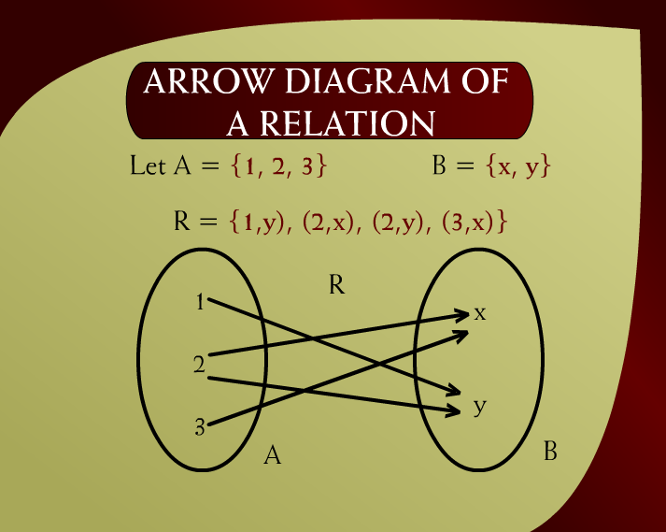
Arrow Diagram of a Relation – (11 - 22)

Slide 32
COORDINATE DIAGRAM (GRAPH) OF A RELATION
R = {(1, y), (2, x), (2, y), (3, x)}

Slide 33
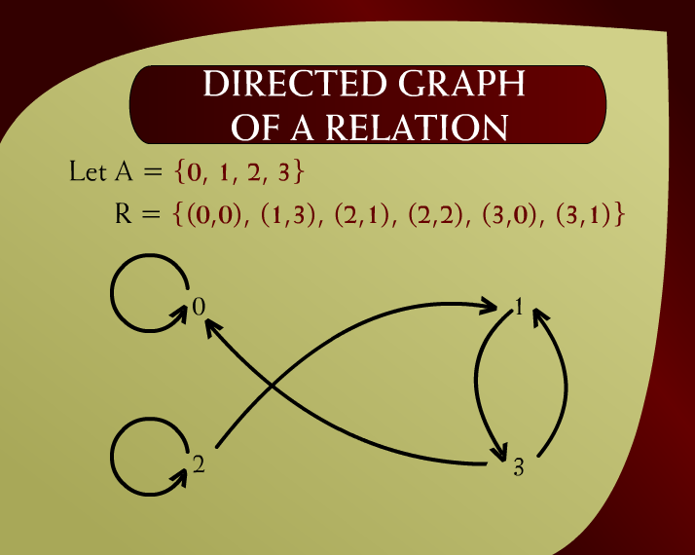
Directed Graph of a Relation – (11 - 23)

Slide 34
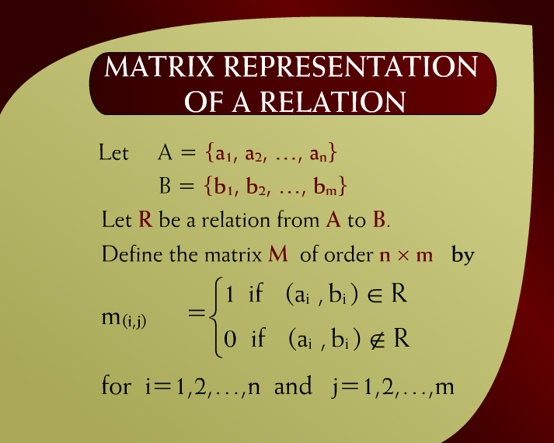
Matrix Representation of a Relation – (11 - 25)

Slide 35
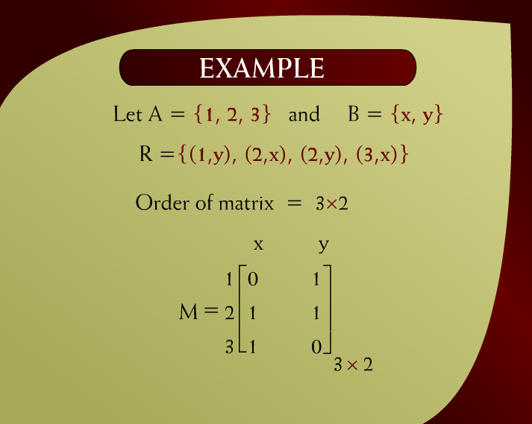
Example – (11 - 26)

Slide 36
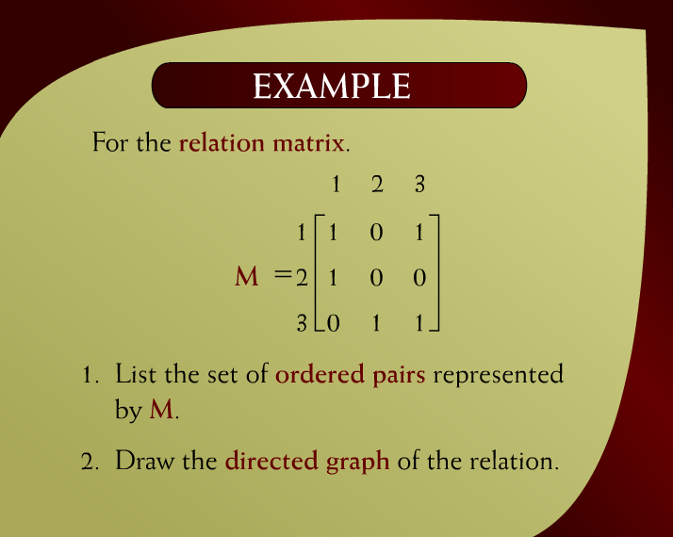
Example – (11 - 27)

Slide 37
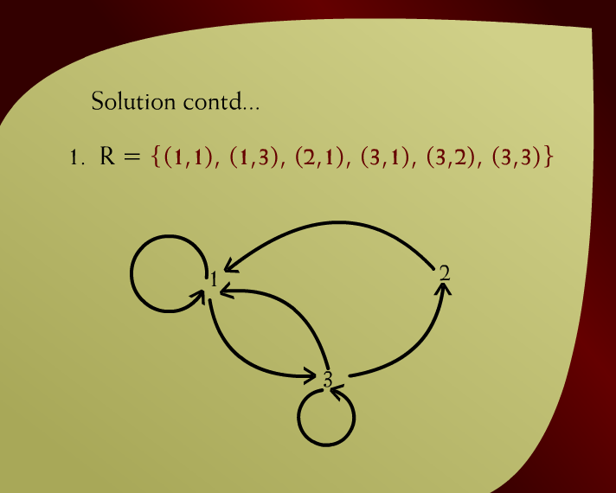
Solution Continued – (11 - 28)

Slide 38

Make Graphs
$\left[\begin{matrix}1 & 1 & 1 \\ 1 & 0 & 0 \\ 1 & 1 & 1\end{matrix}\right]$
$\left[\begin{matrix}1 & 0 & 1 \\ 1 & 0 & 1 \\ 1 & 0 & 1\end{matrix}\right]$
$\left[\begin{matrix}1 & 0 & 0 \\ 0 & 1 & 0 \\ 1 & 1 & 1\end{matrix}\right]$

Slide 39
Common Uses of Relations
Databases: The concept of a relation is the foundation of Relational Databases (like MySQL, SQL Server, etc.).
Each table in a database is a relation, and rows represent tuples (records).
Example: A table Students(StudentID, Name, CourseID) shows a relation between students and courses.
Graph Theory / Networks: Relations are used to represent connections (edges) between nodes (like friends in a social network or links on the web).
Artificial Intelligence and Knowledge Representation: Relations express how objects or concepts are linked — for example, isParentOf, isPartOf, or isConnectedTo.
Programming and Logic: In logic programming (like Prolog), relations are used to describe facts and rules about data.
Mathematical Modeling and Automata Theory: Relations define state transitions (e.g., in finite automata, one state is related to another by an input symbol).

Slide 40
Types of Relations
In discrete mathematics (and set theory), a relation is a subset of the Cartesian product of two sets.
There are several types of relations, based on their properties.
Reflexive Relation
Symmetric Relation
Transitive Relation

Slide 41
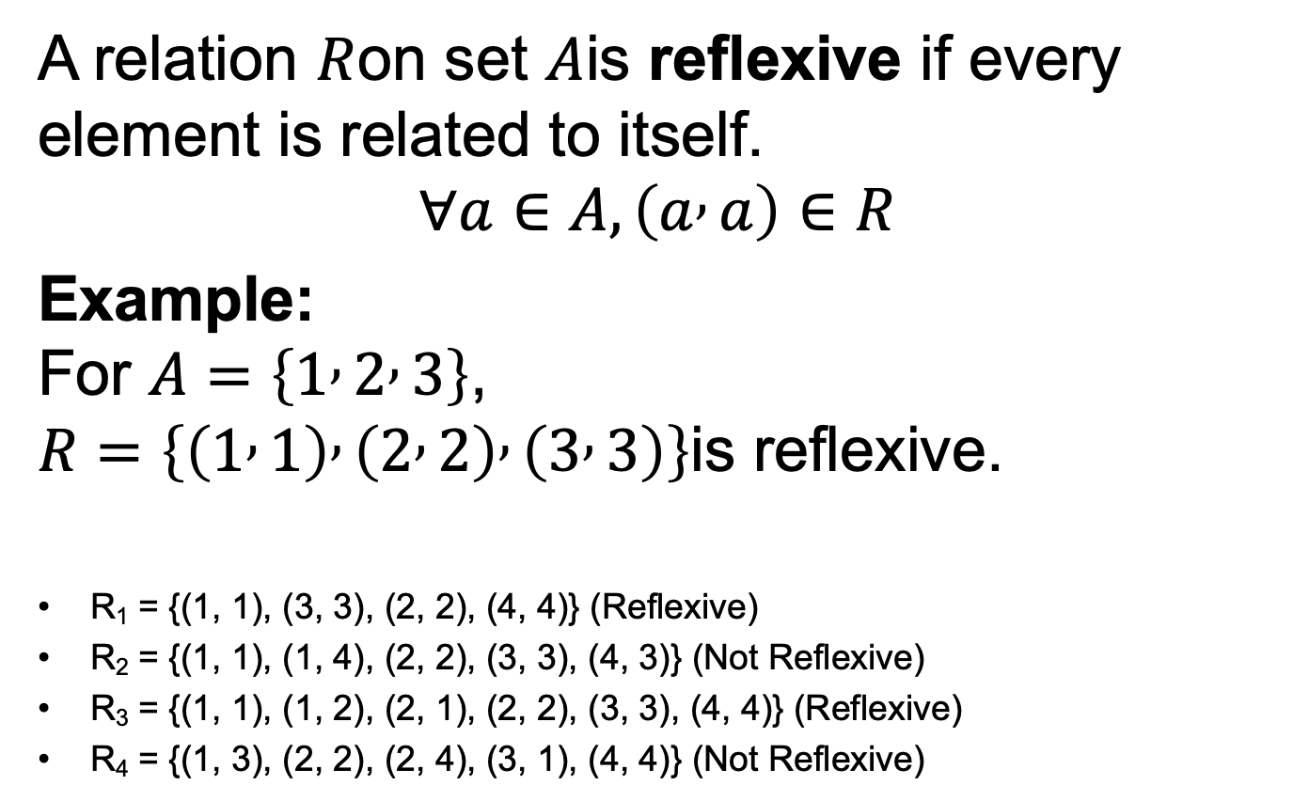
Reflexive Relation
A relation $R$on set $A$is reflexive if every element is related to itself.
$$∀a∈A,\left(a , a\right)∈R$$
Example: For $A=\left\{1 , 2 , 3\right\}$, $R=\left\{\left(1 , 1\right) , \left(2 , 2\right) , \left(3 , 3\right)\right\}$is reflexive.
R₁ = {(1, 1), (3, 3), (2, 2), (4, 4)} (Reflexive)
R₂ = {(1, 1), (1, 4), (2, 2), (3, 3), (4, 3)} (Not Reflexive)
R₃ = {(1, 1), (1, 2), (2, 1), (2, 2), (3, 3), (4, 4)} (Reflexive)
R₄ = {(1, 3), (2, 2), (2, 4), (3, 1), (4, 4)} (Not Reflexive)

Slide 42
Reflexive Relation

Slide 43
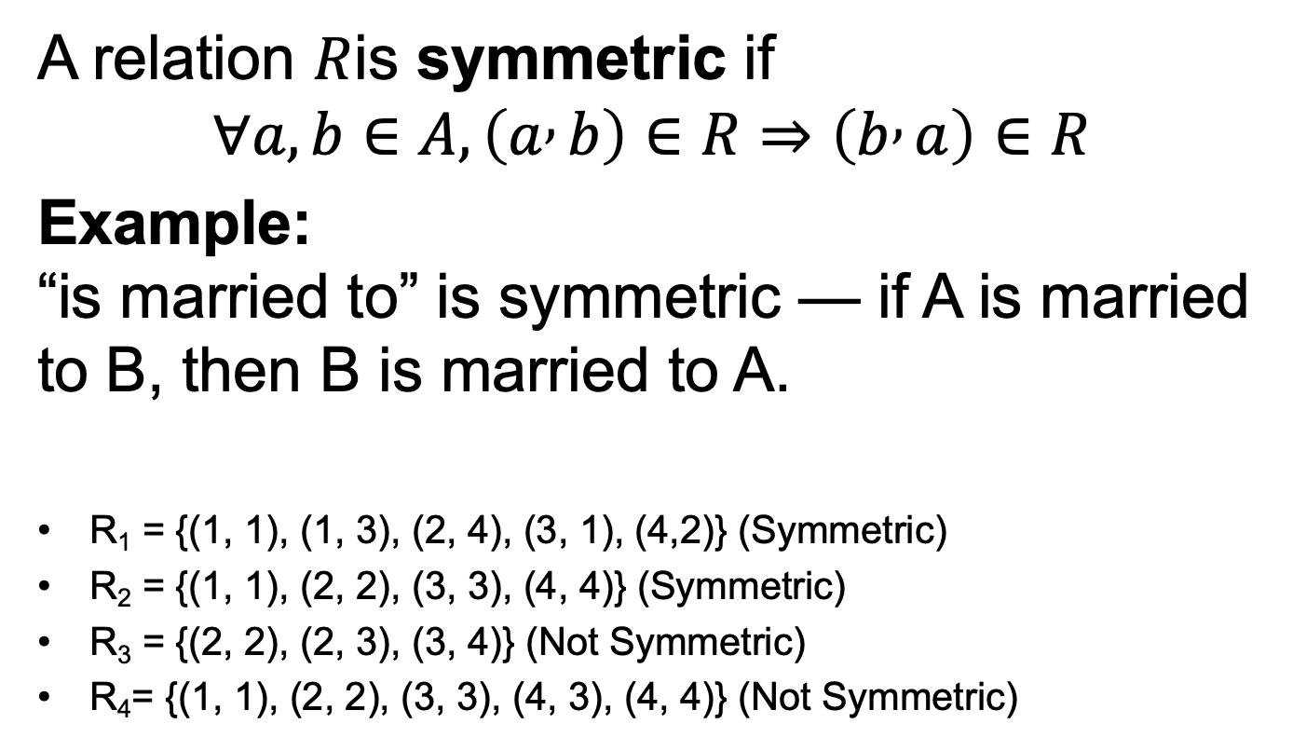
Symmetric Relation
A relation $R$is symmetric if
$$∀a,b∈A,\left(a , b\right)∈R⇒\left(b , a\right)∈R$$
Example: “is married to” is symmetric — if A is married to B, then B is married to A.
R₁ = {(1, 1), (1, 3), (2, 4), (3, 1), (4,2)} (Symmetric)
R₂ = {(1, 1), (2, 2), (3, 3), (4, 4)} (Symmetric)
R₃ = {(2, 2), (2, 3), (3, 4)} (Not Symmetric)
R₄= {(1, 1), (2, 2), (3, 3), (4, 3), (4, 4)} (Not Symmetric)

Slide 44
Symmetric Relation

Slide 45
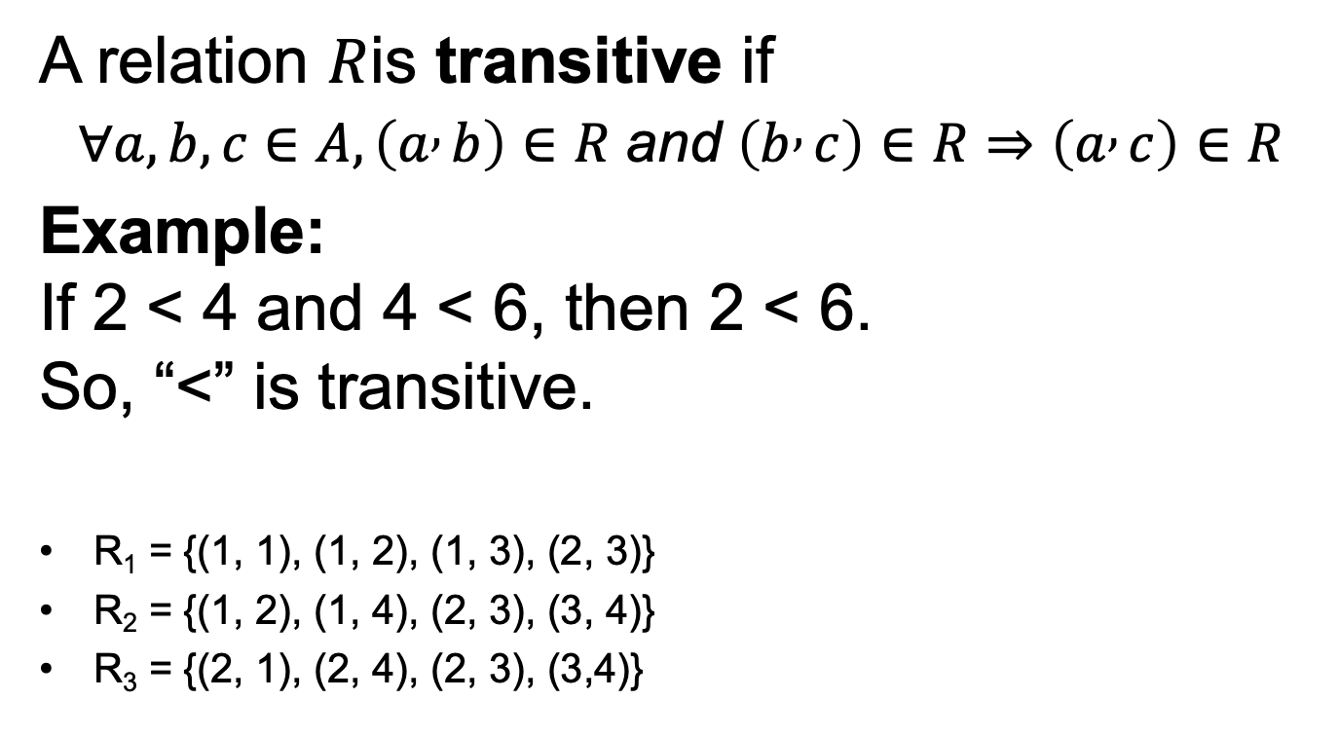
Transitive Relation
A relation $R$is transitive if
$$∀a,b,c∈A,\left(a , b\right)∈R \text{and} \left(b , c\right)∈R⇒\left(a , c\right)∈R$$
Example: If 2 < 4 and 4 < 6, then 2 < 6. So, “<” is transitive.
R₁ = {(1, 1), (1, 2), (1, 3), (2, 3)}
R₂ = {(1, 2), (1, 4), (2, 3), (3, 4)}
R₃ = {(2, 1), (2, 4), (2, 3), (3,4)}

Slide 46
Transitive Relation

